Slide 1

Technology
MPA CPD
28 July 2025

Slide 2


Slide 3
Announcement for MPA LMS Users
To ensure a more convenient and systematic experience while using the LMS, you are advised to follow these guidelines:
Maintain “ONE and ONLY ONE” account.
Use your OFFICIAL name with correct spelling, without any titles (Daw, Tr., Sir, etc.).
To display your name correctly on LMS, go to your profile and change it to your full name as shown in the following slide.
Save your work on a WORD document.
Save your file with a file name (Your Official Name and Date) before submitting your work.
Submit your work ONCE only.

Slide 4
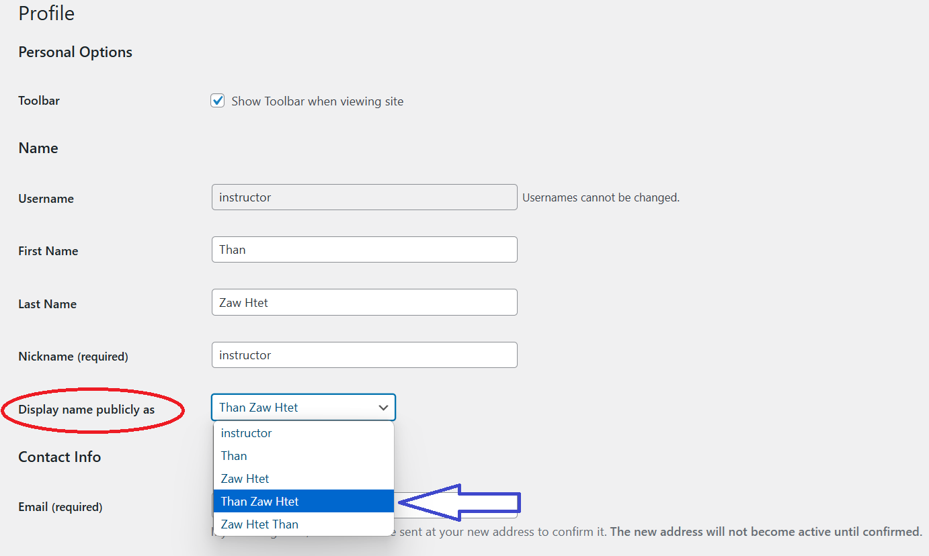

Slide 5
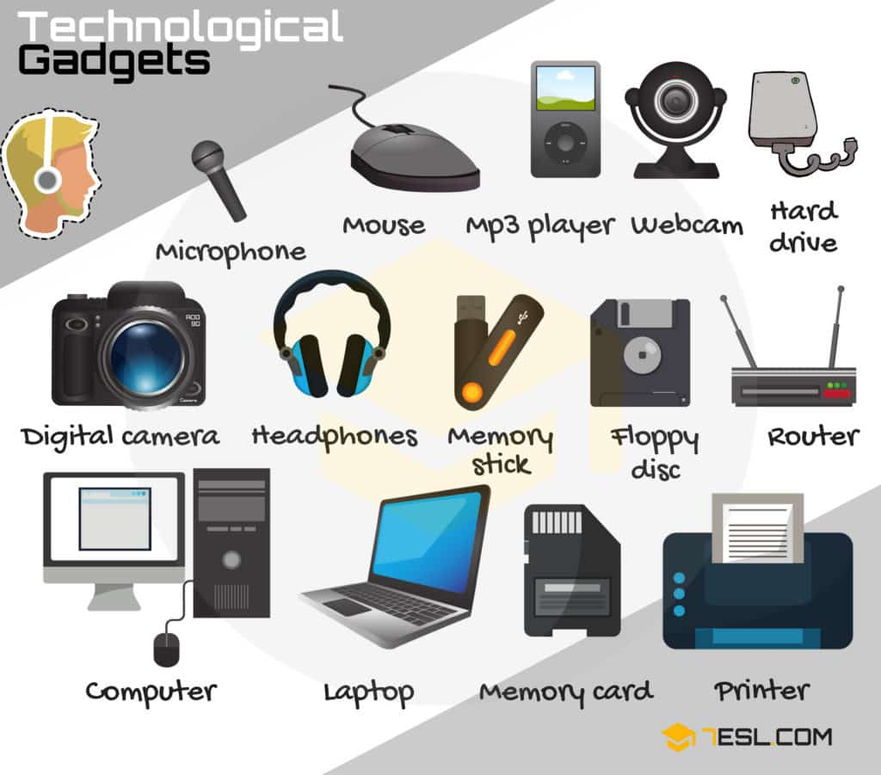

Slide 6
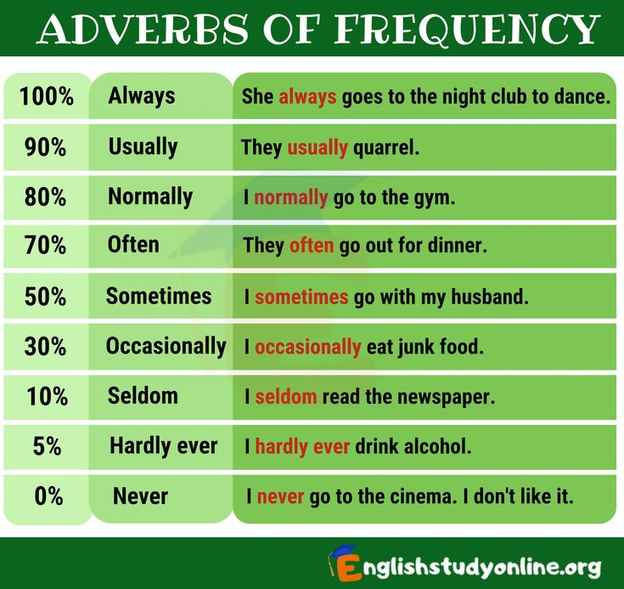

Slide 7
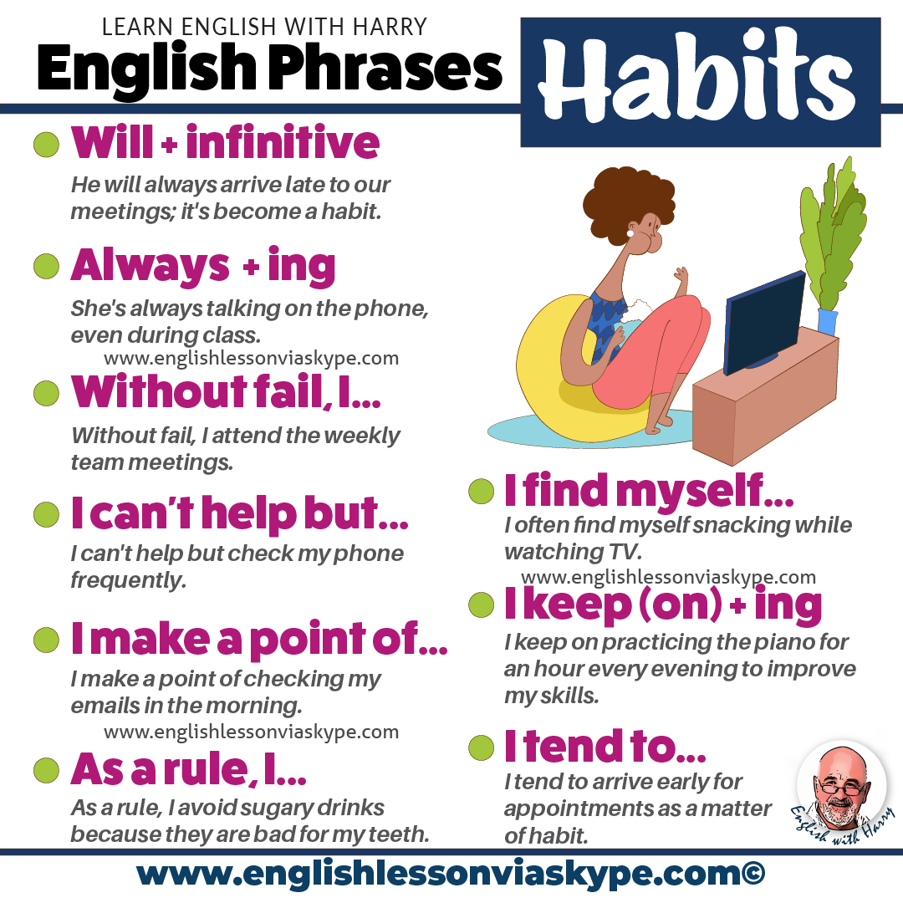

Slide 8


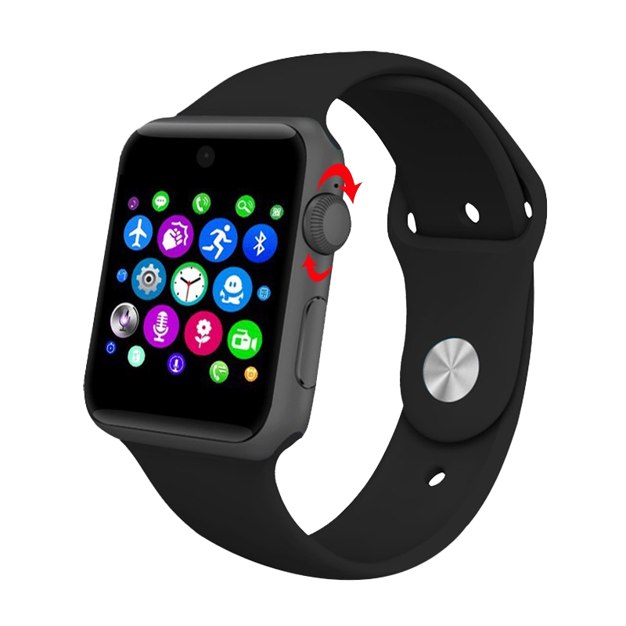

Slide 9


Talk Time
What technological gadget do you think you can’t live without?
How much time do you spend online each week? Is it too much time, or a reasonable amount?
What are some of your favorite websites and applications? What can you do on them?
Some people dislike or fear technology. Do you know anyone like this?
Is there a tech product you want these days? What is it? How will it make your life better?
How do you feel about dating websites/apps? Would you use one?
https://printdiscuss.com/technology-conversation-questions/

Slide 10

https://mrhenriquez.medium.com/how-to-write-structured-paragraphs-the-secret-to-txxxc-paragraph-structure-2977abc6c2b7

Slide 11
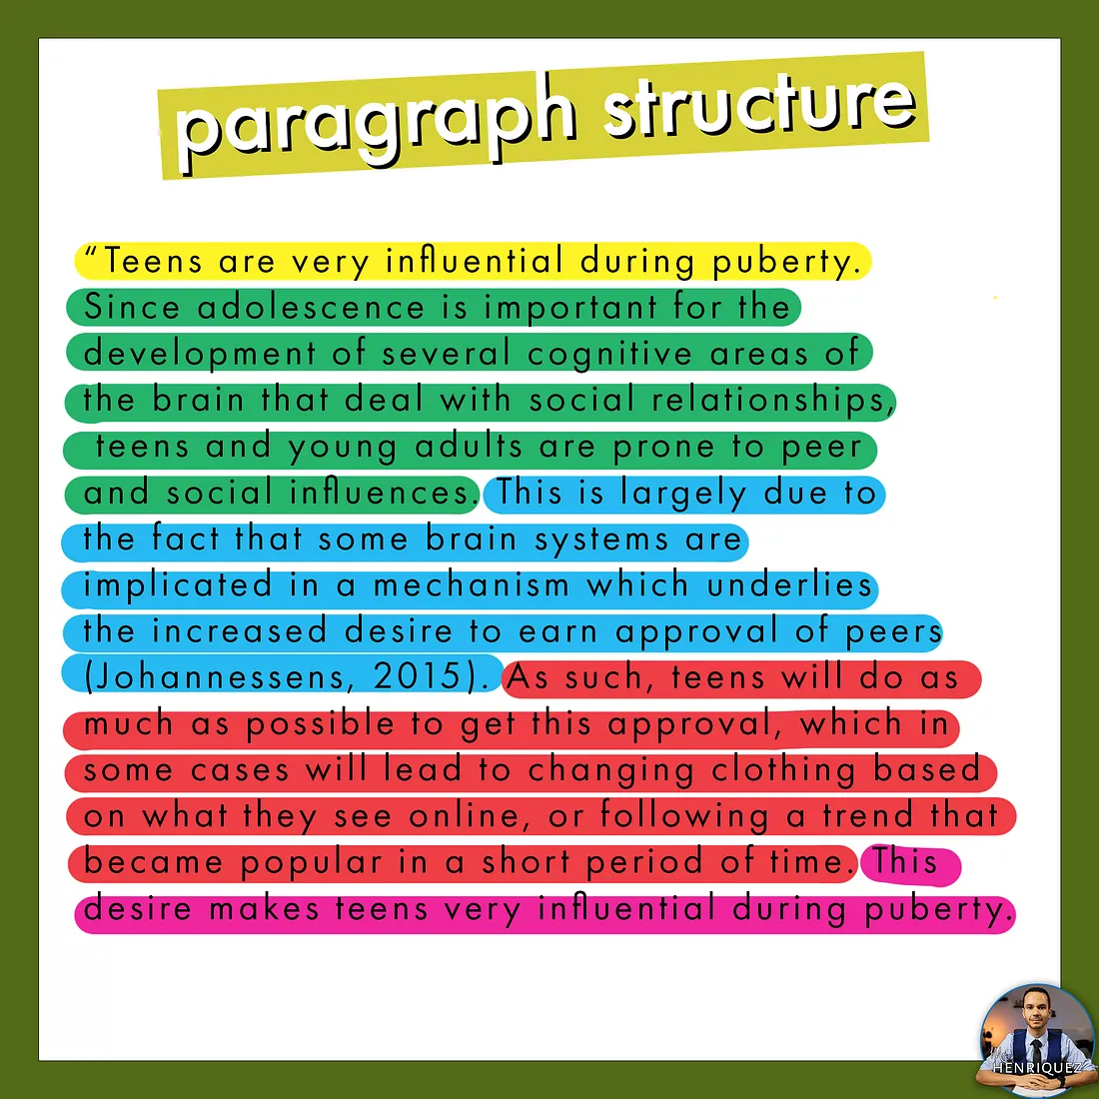
https://mrhenriquez.medium.com/how-to-write-structured-paragraphs-the-secret-to-txxxc-paragraph-structure-2977abc6c2b7

Slide 12
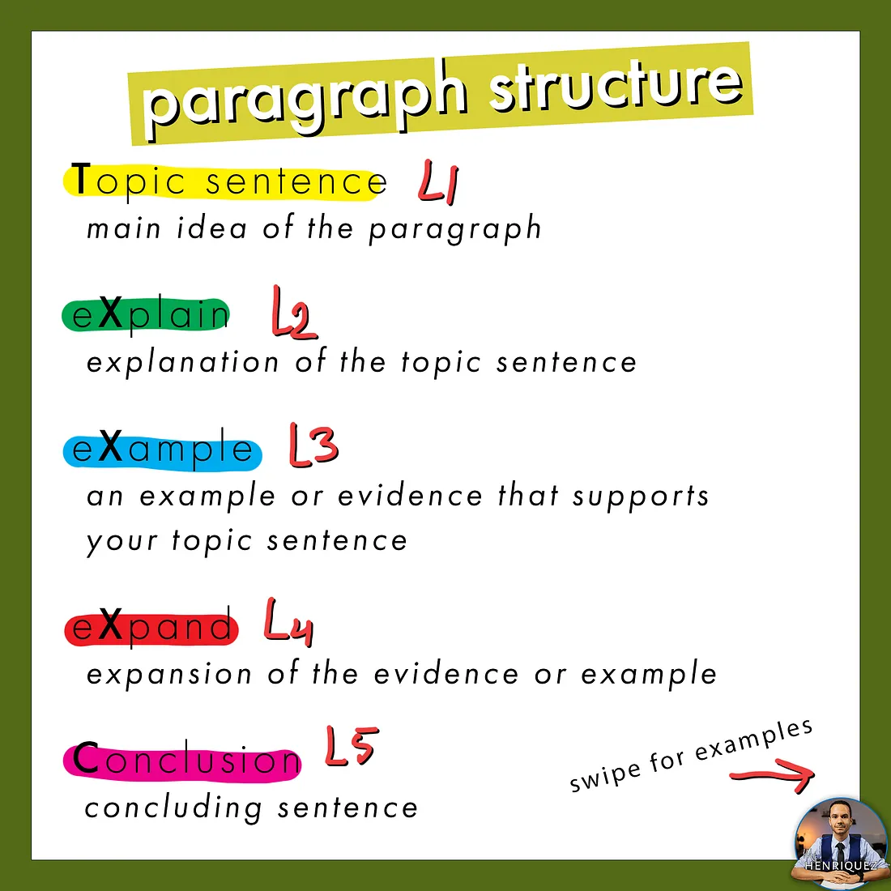
https://mrhenriquez.medium.com/how-to-write-structured-paragraphs-the-secret-to-txxxc-paragraph-structure-2977abc6c2b7

Slide 13
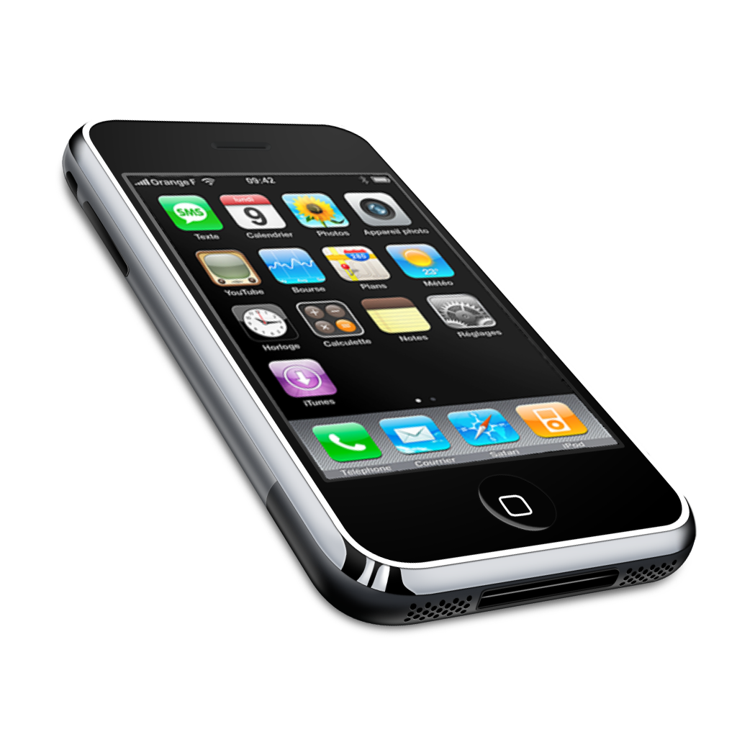
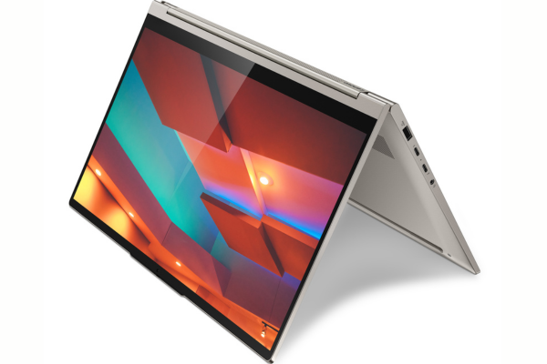
Learning at Leisure
Read
Write
Do you think you have “technophobia”?
Check your answers by reading the article from the following link.
https://www.eslprintables.com/reading_worksheets/reading_comprehension/TECHNOPHOBIA_246490/
Write a structured paragraph on “Your Technological Habits”. (70 – 100 words)
Use the vocabulary on technology and the paragraph structure.

Slide 14
Learning at Leisure
Technology vocabulary
https://promova.com/english-vocabulary/technology-vocabulary
Technology
https://test-english.com/explanation/b1-b2-vocabulary-explanations/technology-b1-english-vocabulary/
Technology vocabulary (IELTS Jacky)
https://www.ieltsjacky.com/technology-vocabulary.html
Wordwall - Devices
https://wordwall.net/resource/56390516/d-t/devices

Slide 15
Learning at Leisure
Technophobia
https://www.eslprintables.com/reading_worksheets/reading_comprehension/TECHNOPHOBIA_246490/
Technology Today and Tomorrow (National Geographic Learning – reading)
https://www.eltngl.com/assets/downloads/rft_pro0000000556/RFT2_CH7.pdf
How to Structure a Paragraph
https://ted-ielts.com/how-to-structure-a-paragraph/
Writing paragraphs: Examples
https://www.futurelearn.com/info/courses/preparing-for-uni/0/steps/1177
Technology conversation questions
https://printdiscuss.com/technology-conversation-questions/

Slide 16


